Slide 1


Actuate
Working with Libraries

Slide 2
About Graphs
Is a control.
Collects a data from a group of data rows.
Groups data into series and categories.
AcGraph is the base class for all types of graphs in actuate.
Not all the graphs use the available properties.
Like Components, graphs are components for which the properties are set for formatting and style.

Slide 3
Types of Graphs
2D and 3D Area Graph.
Tape Graph.
2D and 3D Bar Graph.
Line Graph.
2D and 3D Pie Graph.
Scatter Graph.
High-Low Close Graph.
Open High Low Close Graph.
Candle Stick Graph.

Slide 4
When to use Pie Graph
To display the percentage and how the data compared to whole, a pie graph is used.
Ex. Showing the sales of a company in the entire region and each region is indicated by different colors.
Can select AcSummaryGraph or AcDetail class as base class and choose the graph type as Pie.
The choice of class depends on the data only.

Slide 5
When to use Bar, Line or Type
To display data that may require a horizontal and vertical axis, especially over time, we can use Bar or Line or Type graph.
Ex. Showing the sales of hardware and software over four different regions.
A bar chart can illustrate combinations of totals for various items or groups.
can choose the Actuate AcSummaryGraph class, and within that class, select the graph type.

Slide 6
When to use Scatter
Choose scatter graph when we need to show points and x-axis and y-axis are numerical value.
Ex. Amount withdrawn from ATM and no. of times of using ATM.
Time is not necessary for their display.
can choose the Actuate AcDetailGraph class, and within that class, select the graph type as GraphScatter.

Slide 7
High-Low or Candlestick
useful for showing points along a relatively short and contained time continuum.
Ex. Stocks or temperature in a day where we record the starting point, High Point, Low Point and Final closing point.
can choose the Actuate AcHLCGraph class, and within that class, select the graph type.

Slide 8
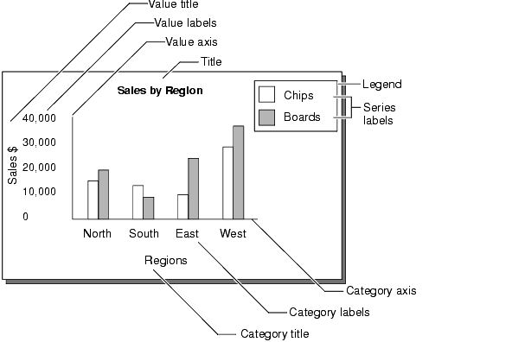
Parts of a Graph

Slide 9
Using Graph in a Report
Place the frame anywhere in the report design where we like to reside the graph.
Insert the Graph component
Select one of the three graph types :-
  Detail Graph for scatter, line and sometimes for pie graph.
  High/Low/Close Graph for open/High/Close and CandleStick graph.
  Summary graph for Pie, Bar, Line and Area Graph.
Select the General->Graph Type property.
Set up the data in the data-stream.
Format the graph.

